Slide 1
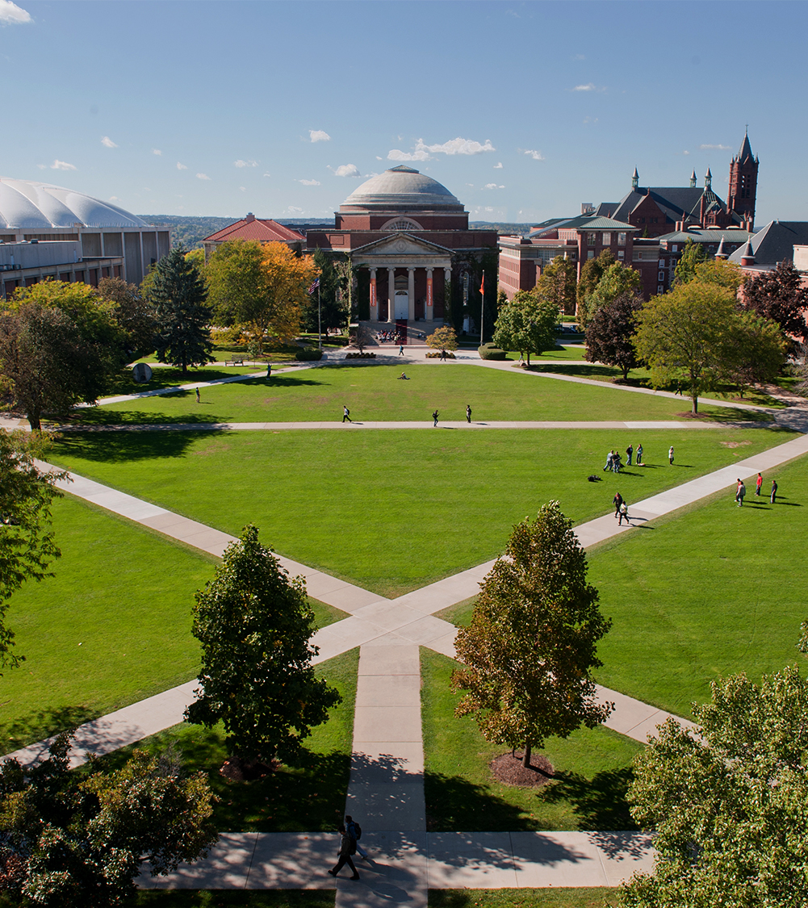
NLG Natural Language Generation
School of Information Studies
Ingrid Fitzgerald
NLP 664
December, 2019

Slide 2
Natural Language Generation (NLG)
NLG is the subfield of AI (artificial Intelligence) and computational linguistics that focuses on computer systems that can produce understandable texts in English or other human languages.
Typically starting from some nonlinguistic representation of information as input, NLG systems use knowledge about language and the application domain to automatically produce documents, report, explanations, help messages and other kinds of texts.
Since the mid-to late 1990s we have seen the emergence of the first fielded NLG applications.
NLG, is also likely to play an important role in human-computer interfaces and will allow much richer interaction with machines than is today. ¹
¹ Building Natural Language Generation Systems. http://assets.cambridge.org/052162/0368/sample/0521620368WSN01.pdf.

Slide 3
NLG overview
Most common use cases include:
Automated article generation
content creation of media
Automated reports, including technical and financial reports.
To be considered as an NLG company, a company's products must be capable of automatically producing text based on a variety of input including tables or other text or hyper text generated.²
This research focused on three companies:
Retresco GmbH (textengine.io)
Articleforge
AX Semantics
These companies currently provide NLG products or services to different industries.
² https://aimultiple.com/nlg-company

Slide 4

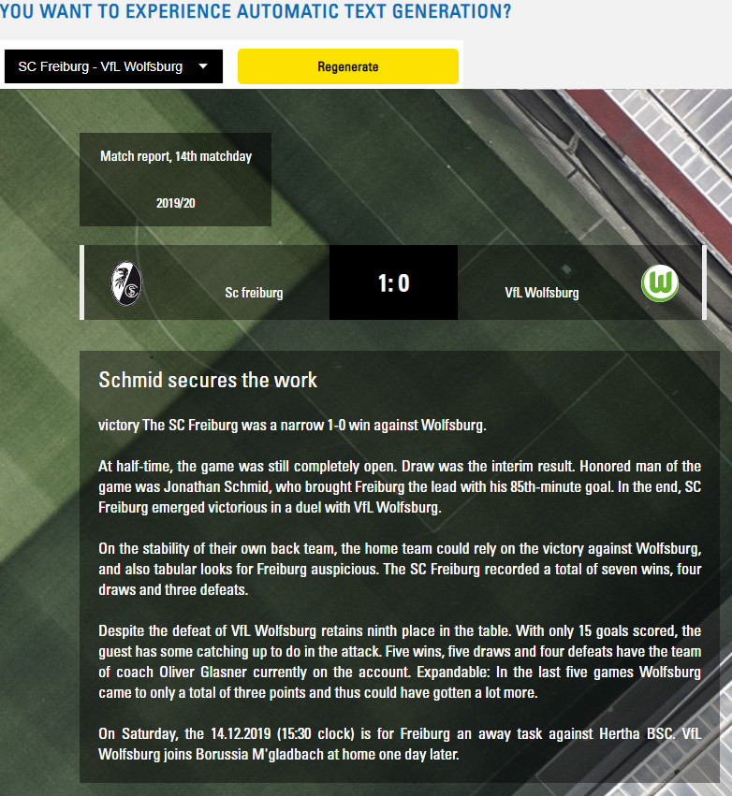
Retresco GmbH (textengine.io)
Demo:
Retresco is a leader in automated content, natural language generation, and artificial intelligence based in Germany.
Their core business focuses on enabling automatic text generation through a managed service with the innovative SaaS platform textengine.io.
Their most most services using NLG technology includes:
Automatic copywriting
robot journalism
Annotation
Content Automation
Asset Performance Reports
financial communications
AI Winter
The demo above shows how NLG can be used for automatic text generation and its application on the creation of a full soccer match report.

Slide 5

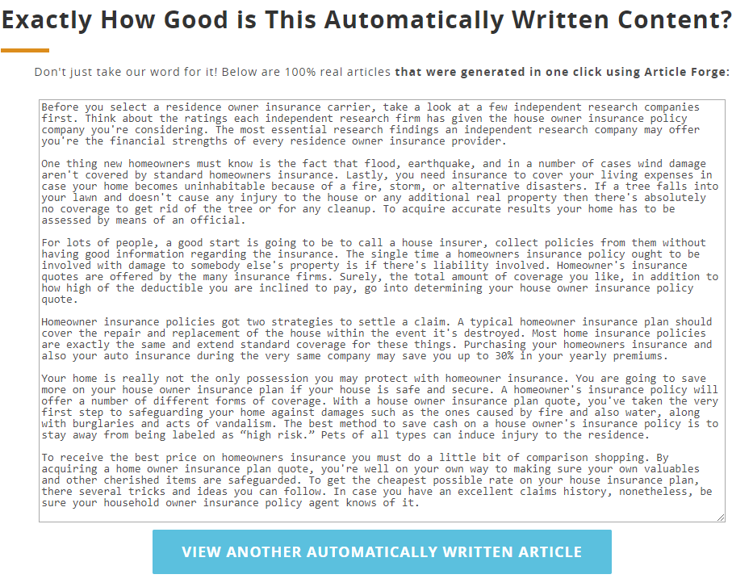
Demo:
Article Forge uses incredibly sophisticated deep understanding algorithms to automatically write articles in the same way that a human does. These deep understanding algorithms allow Article Forge to research ANY topic, exactly like a human does. Article Forge reads millions of articles, learning everything it needs to know so that it can write about any topic in its own words.
Their most relevant services and products using NLG technology includes:
One Click Article Generation
Automatically generates Posts to Blogs
Unique Content that Passes Copyscape
Automatically Generate Content in 7 Languages
Automatically Add Titles, Links, Videos, Images, and More.
The demo above shows how NLG technology could be used to generate articles on-demand with just some pre-trained data.

Slide 6

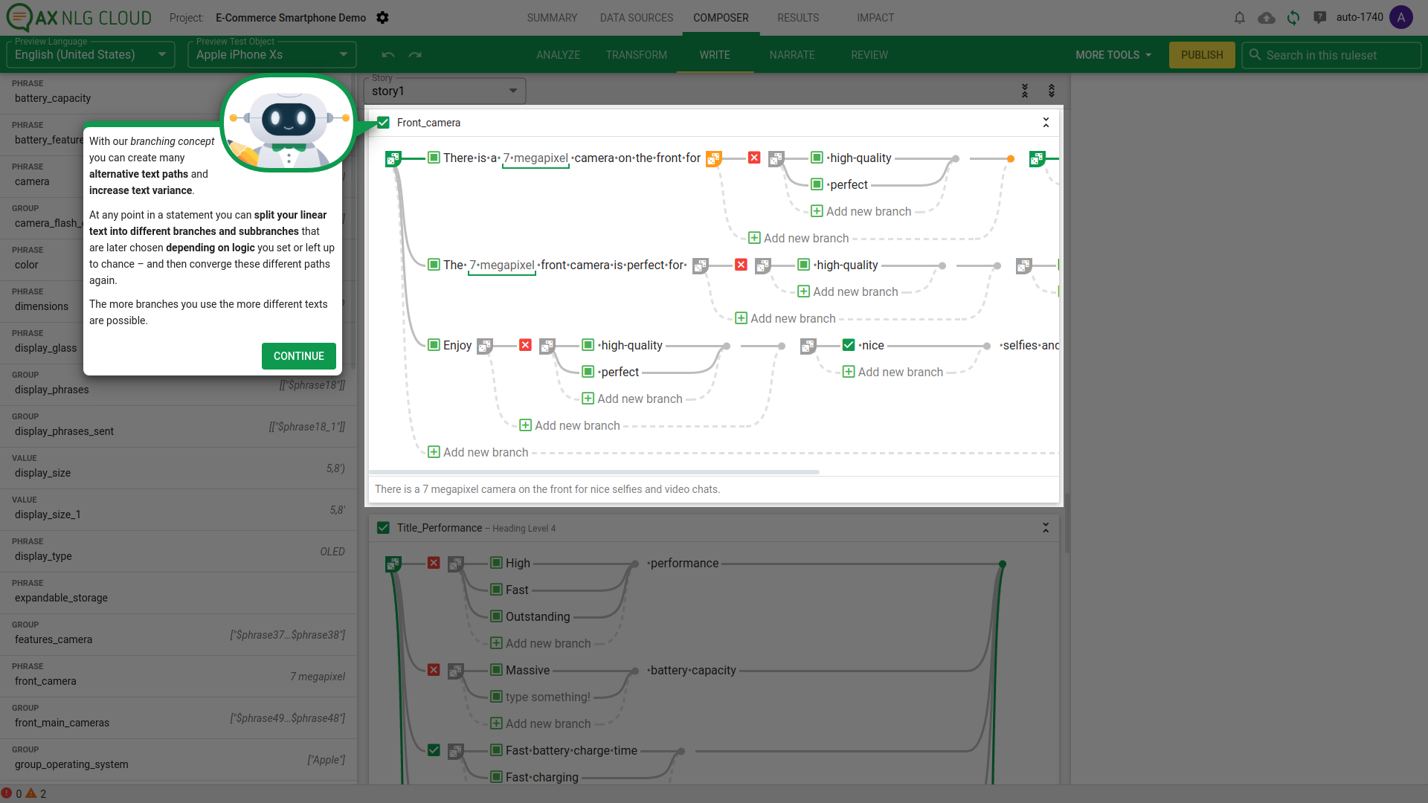
AX semantics
Demo:
AX semantics is an NLG self-service business solutions.
Their software runs 100% on Saas and provide customers with text automation and data analysis providing the customers data connections for the creation of their text.
Their competitive advantage resides on letting the customers choose their own data sources, and the tonality of the texts.
Their most relevant services and products using NLG technology includes:
Multi- and Cross Language Text Generation
Automatic creation of content for website
Natural Language Output based on Structured Data allows users to configure projects to any structure and import formats
The demo above shows automatic creation for content for a website where the users are allowed to use their sources and tonality of their text.

Slide 7
Exciting current trends in NLG
Incorporating discrete latent variables into NLG
May help with modeling structure in tasks that really need it, like storytelling and task-oriented dialogue
Alternatives to strict left-to-right generation
Parallel generation, iterative refinement, top-down generation for longer pieces of text
Alternative to maximum likelihood training with teacher forcing
More holistic sentence-level (rather than word-level) objectives³
³ Stanford, Natural Language Processing with Deep Learning CS224 https://web.stanford.edu/class/cs224n/slides/cs224n-2019-lecture15-nlg.pdf

Slide 8
References and resources :
NLG providers:
Retresco: https://www.retresco.de/
Articleforge: http://www.articleforge.com/
AX Semantics: https://en.ax-semantics.com/
Research papers:
Natural Language Generation Challenges for Explainable AI
Table-to-Text Natural Language Generation with Unseen Schemas
Quantifying Exposure Bias for Neural Language Generation
Natural Language Generation at Scale
Evaluating the State-of-the-Art of End-to-End Natural Language Generation: The E2E NLG Challenge
End-to-End Content and Plan Selection for Data-to-Text Generation
Presentations:
http://www.inf.ed.ac.uk/teaching/courses/nlg/lectures/2011/NLG2011Lect1.pdf
Books on NLG:
Building Natural Language Generation Systems
New Concepts in Natural Language Generation (Helmut Horacek December 17, 2015 Bloomsbury Publishing)

